Slide 1
Props, Lists, and Stateful Components
Lesson 19.2

Slide 2
Components

Slide 3
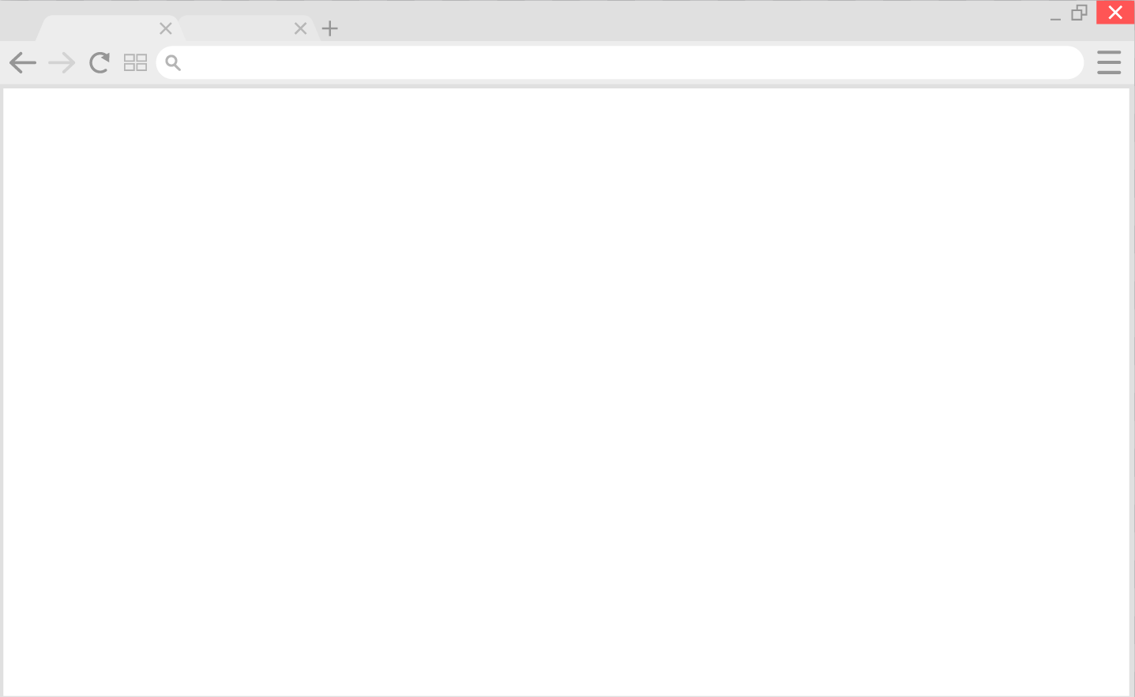
Components
Components are JavaScript functions that return a part of an application’s UI. Think of them as the building blocks of a React application.
Browser UI Tree
1
1
3
2
4
2
3
5
4
5
Notes:
shutterstock_1171093366

Slide 4
Components
Components let you split the UI into independent, reusable pieces and to consider each piece in isolation.
Browser UI Tree
1
1
3
2
4
2
3
5
4
5
Notes:
shutterstock_1171093366

Slide 5
Components
Components are organized into a tree structure, just like HTML elements in the DOM.
App
Todos
User
Todo
Todo

Slide 6
Components
By separating elements into components:
Layout and logic are bundled together in a self-contained package.
Components can be reused throughout the application without needing to be re-coded.
Testing is easier (e.g., having one reusable component means only one UI element needs to be tested).

Slide 7
JSX

Slide 8
JSX is a preprocessor step that adds XML syntax to JavaScript.
JSX makes React more elegant.

Slide 9

JSX
JSX looks like HTML, but there are some differences you need to know about.
React’s documentation covers the gotchas to look out for.
JSX
Notes:
shutterstock_790790974

Slide 10
JSX Curly Braces
Use curly braces { } in JSX code to embed JavaScript expressions.
Evaluating a JavaScript variable:
const yellowStyle={color: 'yellow'} <Star style={yellowStyle} />
Which is same as:
<Star style={{color: 'yellow'}} />

Slide 11

JSX Curly Braces
JSX curly braces { } can be compared to the double curly braces {{ }} in Handlebars.

Slide 12
Props

Slide 13
Props are like function arguments that you can pass to components for them to use.

Slide 14
Props
Can be passed to a component by attaching attributes to the JSX that render the component, similar to how you attach attributes to HTML elements
Considered immutable (something you can’t change)
Can be used to change the default behavior of a component

Slide 15
ReactDOM.render

Slide 16
ReactDOM.render
ReactDOM
ReactDOM.render()
ReactDOM is a library separate from React with methods for working with the DOM.
ReactDOM.render() renders a single root component to the Virtual DOM, and then the real HTML DOM. We typically call this method only once per React application.

